Slide 1
Azure Adventure Day - October 2024
Team Name: VS AUTO
Title: Intelligent Monitoring & Proactive Troubleshooting
Business Units: Global Engg
Team:
Vigneshwararaj Sathianarayanan
Sachin Kadav
Title & Introduction

Slide 2


Intelligent Monitoring & Proactive Troubleshooting
Challenges : Datadog demands substantial manual work for log categorization and root cause analysis, causing delays in resolving system issues.
Solution: Leverage Azure Log Analytics to analyze, group, and extract insights from logs using AI/ML.
Key
Benefits
Automated
RCA
Log Categorization
Contextual Insights
Proactive Monitoring​
Automated clustering of log pattern Accelerates the identification of underlying issues.
Implement NLP-based log categorization
Leverage Azure Cognitive Services and ML to improve log categorization.
Critical context and predictive insights from logs
Based on the insights, logs are clustered using K means clustering with silhouette score.
Leverage Azure Monitor and Azure ML to create a model
Alert thresholds with KQL based on logs patterns with historical data
Key Microsoft Azure Components
Azure Data Explorer/Log Analytics
Azure AI Service
Azure ML
KQL

Slide 3




Solutioning – Building blocks, Flow
Data Collection from the services
ADX/LOG ANALYTICS WORKSPACE
7
DASHBOARD
Data
Collection
Logs collections
Ingestion into ADX/Log Analytics
Ingestion
KQL
1
2
KQL
Azure AI Service
Text Analytics
Extract Insights from Logs
Store in Custom Table in ADX
Data
Processing
6
4
ADX/LOG ANALYTICS WORKSPACE
ADX/LOG ANALYTICS WORKSPACE
AZURE AI SERVICE (AZURE COGNITIVE SERVICE)
CLUSTERING MODEL
TEXT ANALYTICS
Advanced Analytics
Azure ML
K-Means Clustering
Group Logs Based on Patterns
Store in Custom Table in ADX
3
4
Azure Dashboard
Real-Time Monitoring, Clustering, and Predictive Analytics
Visualization
5
AZURE MACHINE LEARNING

Slide 4
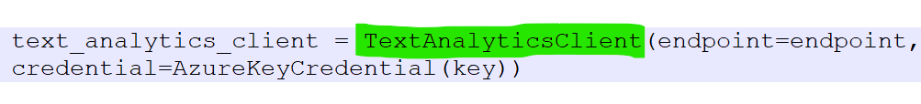
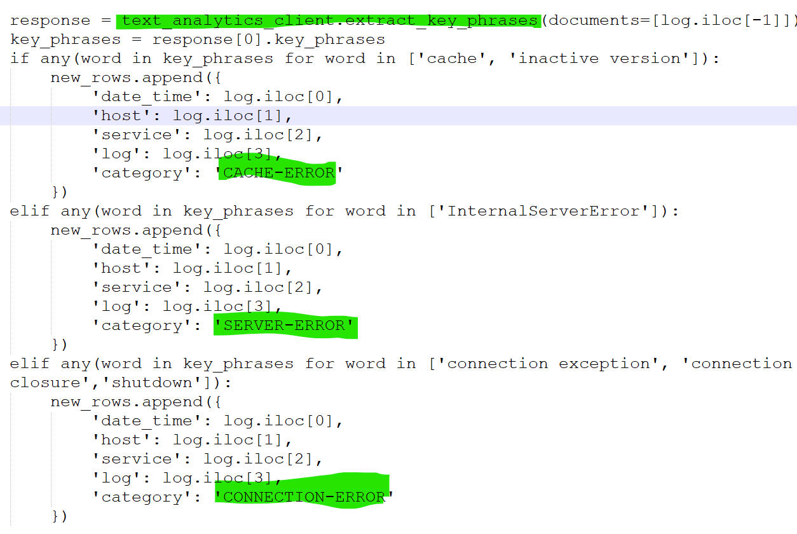
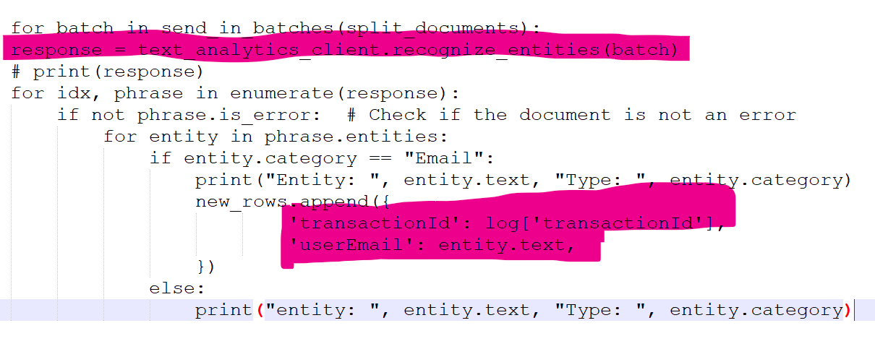
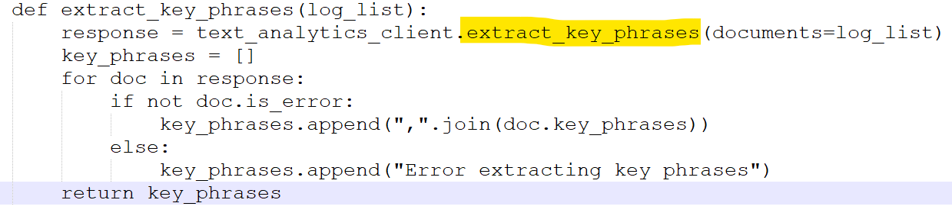
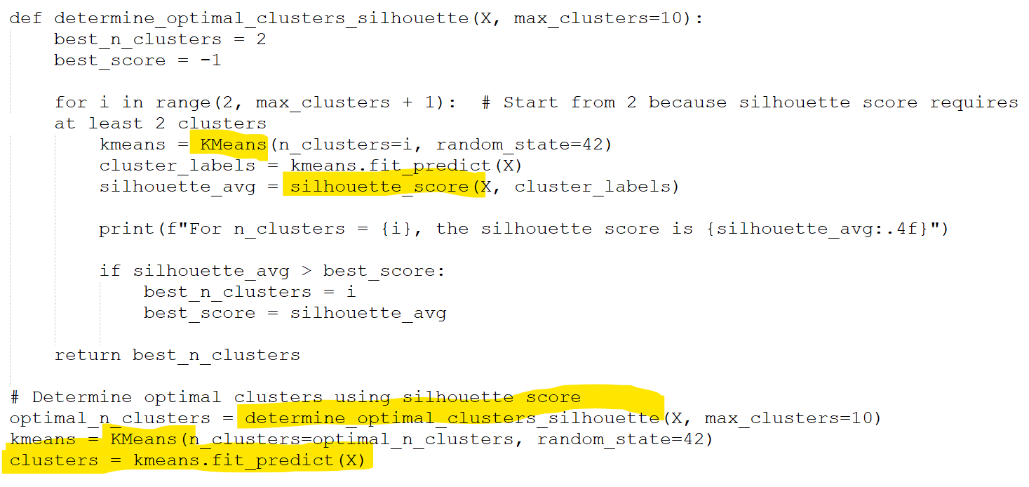
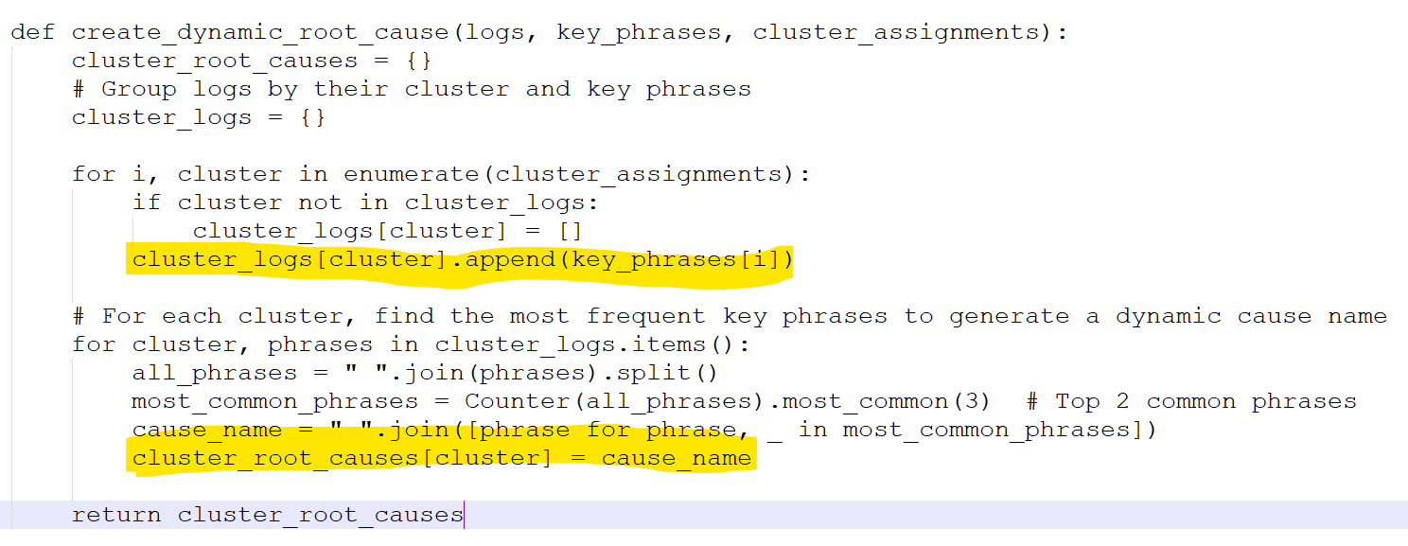
POC Code
Log Categorization
Grouping Based on user ID
Text Analytics for Root Cause analysis
Number of Clusters for K means Algorithm
K means Clustering

Slide 5
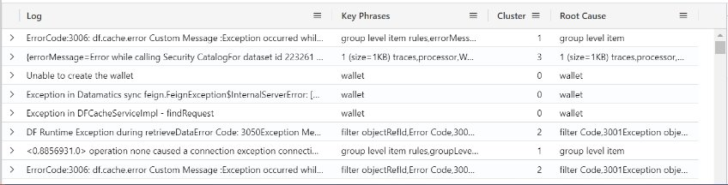
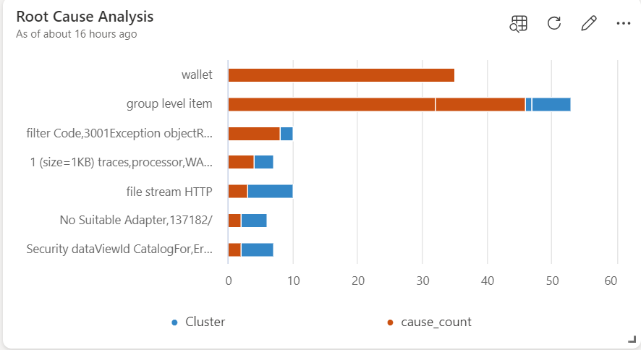











Automated Root Cause Detection
Datadog Limitation
Root cause analysis is manual
slows down identifying the cause of system issues.
Azure Cognitive Services, Azure ML & Clustering Algorithms
Implement Clustering Algorithm
Analyze the specific content of log messages and cluster logs based on their context, enabling proactive issue identification.
Solution
Automatic Clustering by K means Clustering to group logs based on their context.
The number of clusters are determined by silhouette score
K- Means Clustering
Accelerates root cause identification by clustering related logs automatically
Reduces manual investigation efforts, improving response times
Benefits
ADX
Azure AI Service
Text Analytics
Azure ML
K means
ADX
Dashboard

Slide 6
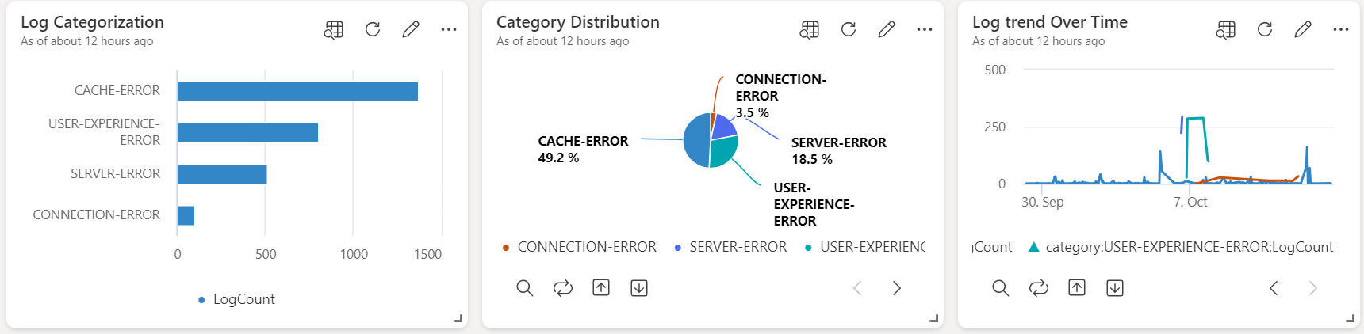
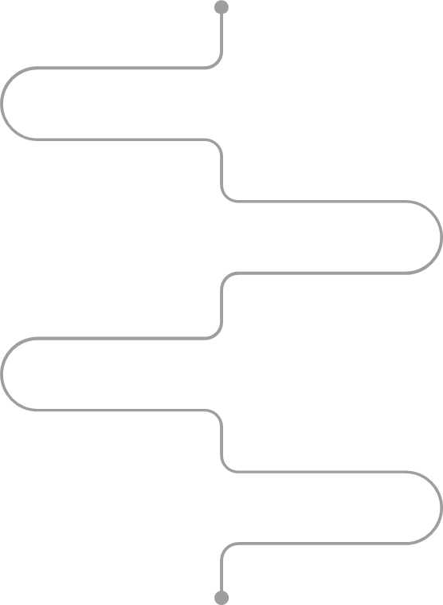


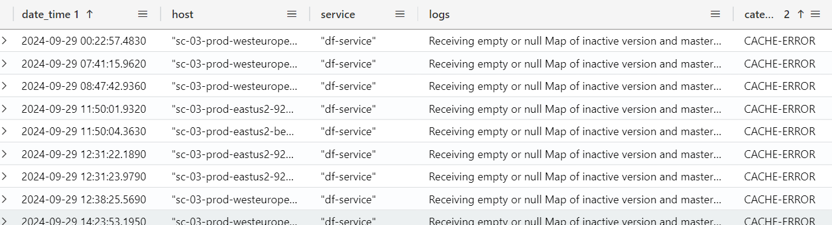

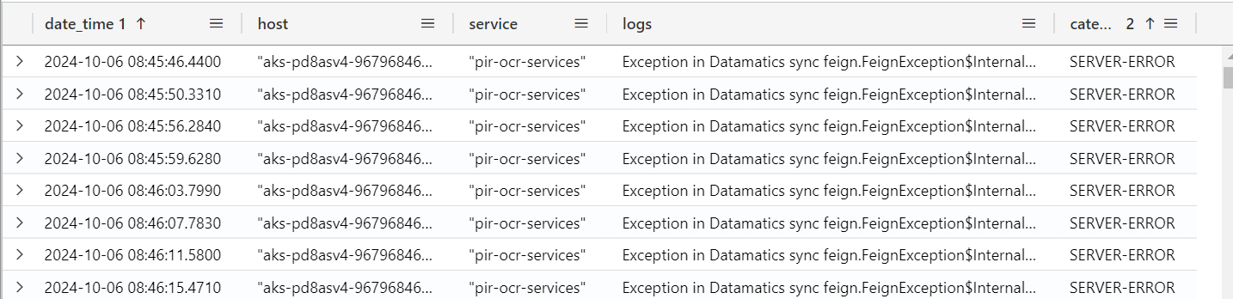



Log Categorization – Azure AI
Datadog Limitation
Logs are tagged only by severity levels (Error, Warning, Info)
Lack of Context: No in-depth understanding of the impact or context of log messages
Azure Cognitive Services
Implement custom log categories (e.g., Cache Error, Server Error, Connection Error)
Analyze the specific content of log messages for enhanced categorization
Tag logs based on these analyses for better context
Solution
Enables context-aware categories that go beyond basic severity levels
Provides direct insights within logs for quicker resolutions
Benefits
ADX
Azure AI Service
Text Analytics
ADX
Dashboard

Slide 7
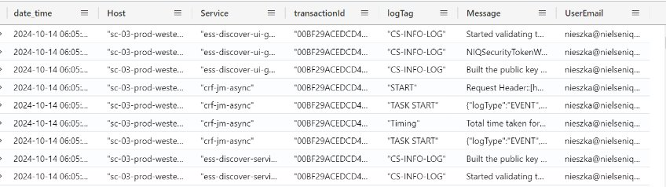







Next Step - User Metrics Analytics by Aggregating logs across all components (E.g user email)
Grouping logs by user email across all services is not possible in Datadog​
Perform Grouping by using Azure Ai Text analytics based on email id (currently implemented)
Grouping –
User Email
After grouping logs based on user email
Use Log Categorization to categorize type of report user runs
Eg: Condition, Rank, general reports etc.
Log
Categorize
Root Cause Analysis
Cluster the errors for each users.
The number of clusters are determined by silhouette score
ADX
Azure AI Service
Text Analytics
ADX
Can identify the granular information for each users
Reduce overuse of data points for a user
based on their historical data we can precache the reports and selection.
User Email Grouping
Benefits
Dashboard
ADX
Root Cause Analysis
Log Categorize

Slide 8




Metrics
Resiliency
Security
Built-in fault tolerance across all Azure services with high availability (HA) zones and redundancy (ADX, Azure ML, AI Service).
Disaster Recovery options with geo-replication and automated failover in case of regional outages.
Azure Active Directory (AAD) integration for role-based access control (RBAC) to secure access to data and logs.
Data encryption at rest and in transit, ensuring secure log storage and transmission.
Scalablity
Costing
Adaptable for various use cases
Auto-scaling in Azure Data Explorer (ADX) and Azure Machine Learning ensures your system can handle increased log volume without manual intervention.
Distributed architecture for both ingestion and analytics, enabling horizontal scaling across services.
Global deployment across regions with Azure AI Service, allowing for scaling user requests and AI-driven processing.
Auto-scaling reduces cost overhead: Only pay for the resources used during peak times.
Optimized storage in ADX for large datasets with tiered data storage (hot, cold) based on usage.
Reduces Manual effort for root cause analysis

Slide 9
Thank You

Slide 13
Automated Root Cause Detection
Datadog Limitation
Root cause analysis is manual
slows down identifying the cause of system issues.
Azure Cognitive Services, Azure ML & Clustering Algorithms
Implement Clustering Algorithm
Analyze the specific content of log messages and cluster logs based on their context, enabling proactive issue identification.
Solution
Automatic Clustering by K means Clustering to group logs based on their context.
The number of clusters are determined by silhouette score
K- Means Clustering
Accelerates root cause identification by clustering related logs automatically
Reduces manual investigation efforts, improving response times
Benefits
ADX
Azure AI Service
Text Analytics
Azure ML
K means
ADX
Dashboard

Slide 14
Log Categorization – Azure AI
Datadog Limitation
Logs are tagged only by severity levels (Error, Warning, Info)
Lack of Context: No in-depth understanding of the impact or context of log messages
Azure Cognitive Service
Implement custom log categories (e.g., Cache Error, Server Error, Connection Error)
Analyze the specific content of log messages for enhanced categorization
Tag logs based on these analyses for better context
Solution
Enables context-aware categories that go beyond basic severity levels
Provides direct insights within logs for quicker resolutions
Benefits
ADX
Azure AI Service
Text Analytics
ADX
Dashboard

Slide 15
Next Step - User Metrics Analytics
Grouping logs by user email across services is not possible in Datadog​
Perform Grouping by using Azure Ai Text analytics based on email id (currently implemented)
Grouping –
User Email
After grouping logs based on user email
Use Log Categorization to categorize kind of report user runs
Eg: Condition, Rank, general reports etc.
Log
Categorize
Root Cause Analysis
Cluster the errors for each users.
The number of clusters are determined by silhouette score
ADX
Azure AI Service
Text Analytics
ADX
Can identify the granular information for each users
Reduce overuse of data points for a user
based on their historical data we can precache the reports and selection.
User Email Grouping
Benefits
Dashboard
ADX
Root Cause Analysis
Log Categorize

Slide 16
Metrics
Resiliency
Security
Built-in fault tolerance across all Azure services with high availability (HA) zones and redundancy (ADX, Azure ML, AI Service).
Disaster Recovery options with geo-replication and automated failover in case of regional outages.
Azure Active Directory (AAD) integration for role-based access control (RBAC) to secure access to data and logs.
Data encryption at rest and in transit, ensuring secure log storage and transmission.
Scalablity
Costing
Auto-scaling in Azure Data Explorer (ADX) and Azure Machine Learning ensures your system can handle increased log volume without manual intervention.
Distributed architecture for both ingestion and analytics, enabling horizontal scaling across services.
Global deployment across regions with Azure AI Service, allowing for scaling user requests and AI-driven processing.
Auto-scaling reduces cost overhead: Only pay for the resources used during peak times.
Optimized storage in ADX for large datasets with tiered data storage (hot, cold) based on usage.
Reduces Manual effort for root cause analysis

Slide 17
Mention about tools leveraged from training and tools that you have explored
Allocate time for each slide
Do all changes discussed
Mention about k-means
Include in heading above graph – which use case is being solved in the grap
Highlight key coding sections in different color
Our Thought Process, Implementation - remove content in top
Change format of roadahead
Mention about cost as follows(indirectly help in following) a.Reduce manual efforts on log triage, troubleshooting b.Clustering can help to build Build repository with log analysis. This can be training data for GenAI usecases c. Actionable insights
Mention security as follows All in Azure setup so can leverage security of Azure Infra
Incase of k-means – how did we come up with number of clusters . Did we use something like elbow point ?
Scalability -> Scalability: K-means can handle large datasets with many data points and can be easily scaled to handle even larger datasets.
Resiliency -> mention how it will be
Costing -> mention about manual effort reduction plus solution built will offer new features that can be useful in Ask Arthur(potentially), can give recommendation in discover etc
Security -> mention its all within azure so secure

Slide 18
Automated Root Cause Detection
Datadog Limitation
Root cause analysis is manual
slows down identifying the cause of system issues.
Solution
Implement Clustering Algorithm
Analyze the specific content of log messages and cluster logs based on their context, enabling proactive issue identification.
Benefits
Accelerates root cause identification by clustering related logs automatically
Azure Cognitive Services, Azure ML & Clustering Algorithms
Reduces manual investigation efforts, improving response times
K Means Clustering
Automatic Clustering by K means Clustering to group logs based on their context.
The number of clusters are determined by silhouette_score

Slide 19
Log Categorization – Azure AI
Datadog Limitation
Logs are tagged only by severity levels (Error, Warning, Info)
Solution
Analyze the specific content of log messages for enhanced categorization
Benefits
Enables context-aware categories that go beyond basic severity levels
Azure Cognitive Service
Provides direct insights within logs for quicker resolutions
Implement custom log categories (e.g., Cache Error, Server Error, Connection Error)
Lack of Context: No in-depth understanding of the impact or context of log messages
Tag logs based on these analyses for better context

Slide 20
Log Categorization – Azure AI
Datadog Limitation
Logs are tagged only by severity levels (Error, Warning, Info)
Solution
Analyze the specific content of log messages for enhanced categorization
Benefits
Enables context-aware categories that go beyond basic severity levels
Azure Cognitive Service
Provides direct insights within logs for quicker resolutions
Implement custom log categories (e.g., Cache Error, Server Error, Connection Error)
Lack of Context: No in-depth understanding of the impact or context of log messages
Tag logs based on these analyses for better context

Slide 21
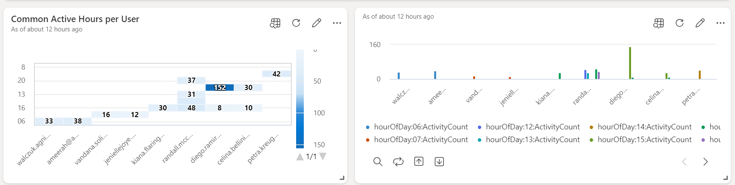
User Metrics Analytics
Datadog Limitation
Grouping logs by user email across services is not possible in Datadog
It relies on transaction IDs, and few logs contain user email information
Solution
Azure Cognitive Services groups logs based on user email, enabling better tracking across services.
Benefits
Accelerates root cause identification by clustering related logs automatically
Azure Cognitive Services
Reduces manual investigation efforts, improving response times
Log Analysis to recognize entities especially user info
Use Automatic Grouping by user email to track logs even when user info is limited.

Slide 22
Next Step ….
Segmentation of User selection
Infra Throttling
​
Reduce overuse of data points
Precaching
Leverage built analytics
segment user selection based on dim selection , fact selection etc...
helps to feed data to GenAI use cases - Ask Arthur to identify when user does “my brand” in contextual search
useful in infra throttling user request by scaling AKS PODS and this will ensure performance is good
Compare current selection with past execution to reduce over-usage of data points prompts user that based on user history their current selection will exceed data point or not
find the common reports run by user and if those reports always fetches from the DB, based on their historical data we can precache the reports and selection.

Slide 23
CASE 1 - Deep Customization: NLP-based Log Categorization
CASE 2 - Enhanced Predictive Capabilities: ML-Driven Root Cause Analysis
CASE 3 - Grouping all logs across the services based on user email id
Current Problem/limitation :
In Datadog, logs are tagged based on severity levels (Error, Warning, Info) but lack in-depth understanding of the impact or context of the log messages.
Azure Cognitive Services:
Logs can be categorized into custom categories such as Cache Error, Server error, Connection error etc.. based on the specific content of the log
Approach
The system can analyze the potential impact, such as service outages, performance degradation, or user experience issues, and tag logs accordingly.
Advantages:
Automated log classification with context-aware categories beyond basic severity.
Provides actionable insights directly within logs.
Tailors log processing based on organizational needs
MAIN FOCUS:
Grouping all logs across the services based on user email id is not possible in datadog currently the logs are grouped based on transaction ids and only few logs have the user info like user email id.
Azure Cognitive Services:
Automatic grouping: Logs are grouped based on user email id. Not all logs have user info like user email id.
Advantages:
Identify insights about user’s common selection and reports they run
Track the logs based on user across all the services
MAIN FOCUS:
Root cause analysis in datadog is typically manual and involves engineers analyzing logs to determine the cause of system issues.
Azure Cognitive Services, Azure Machine Learning & Clustering Algorithms:
Automatic Clustering: Logs are clustered based on similarities such as time, user session, and resource utilization. The system can then automatically detect patterns in failures (e.g., "Database Connection Timeout")
Proactive Issue Identification: The platform proactively groups related logs, offering engineers immediate insights into the most likely causes of problems.
Advantages:
Speeds up root cause identification by automatically clustering logs related to failures.
Reduces manual effort in investigating errors, enabling quicker response times.
Evidence
Evidence
Evidence
Steps involve in Implementing the machine learning lifecycle in Azure Monitor Logs:
Query logs using KQL in Azure Monitor Logs
Examine and understand the logs collected.
Build and training Clustering model (K means)
Automate your pipeline to retrain your model regularly on current data.
Use Azure Dashboard to visualize the data

Slide 24
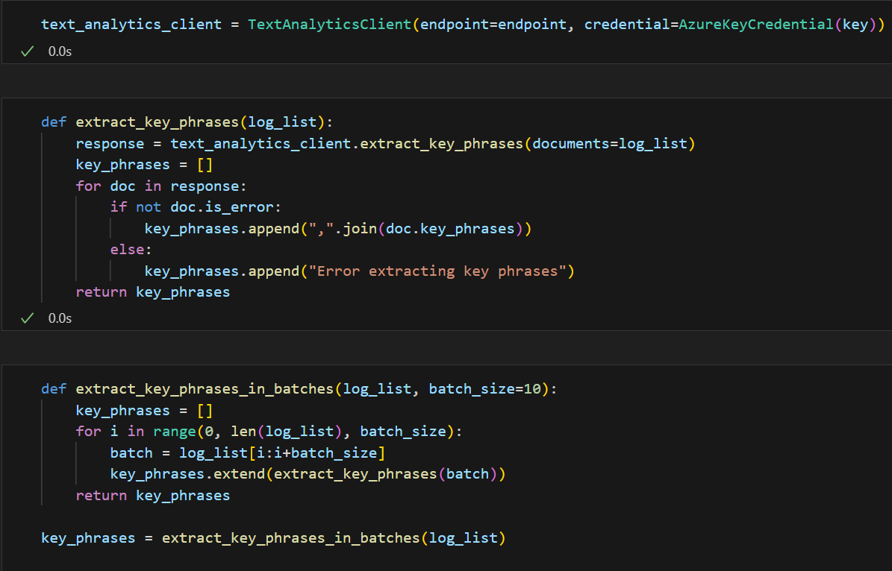
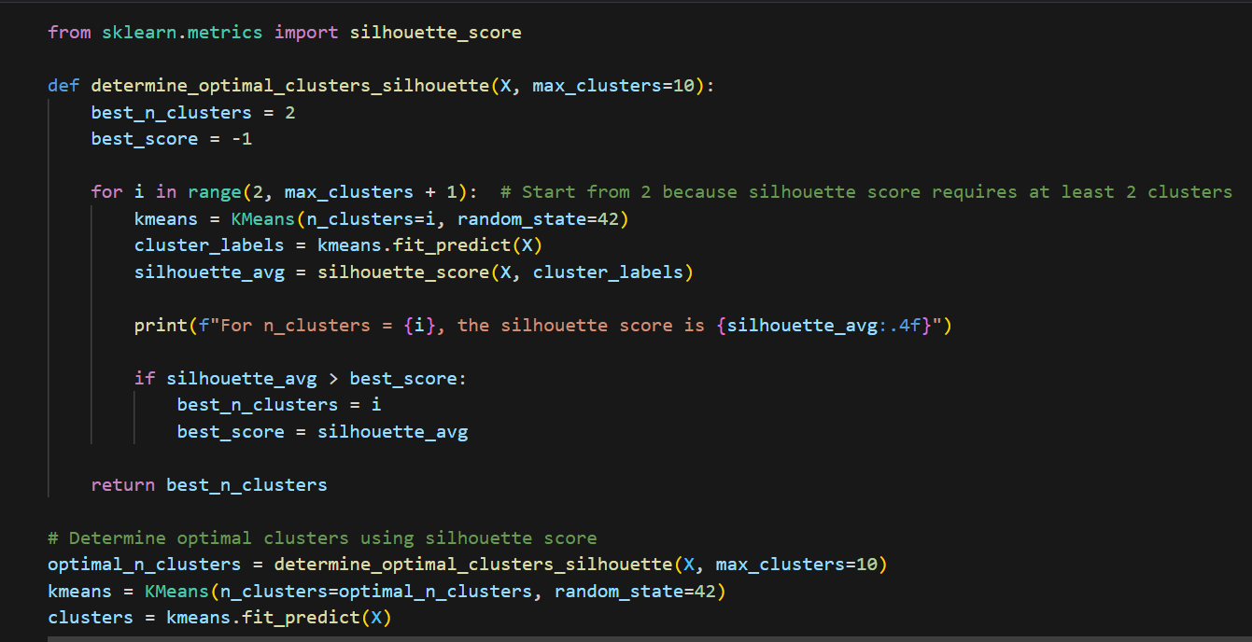
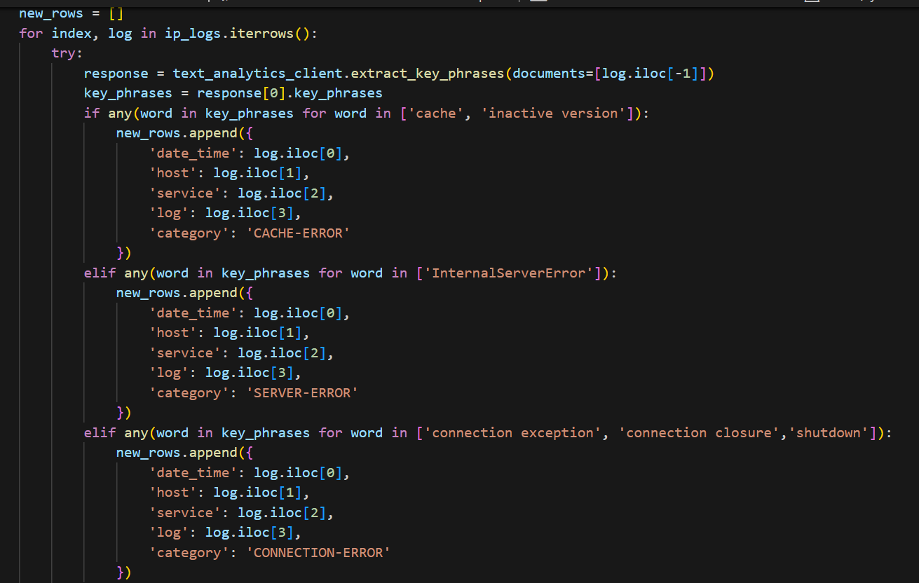
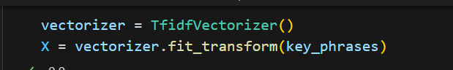
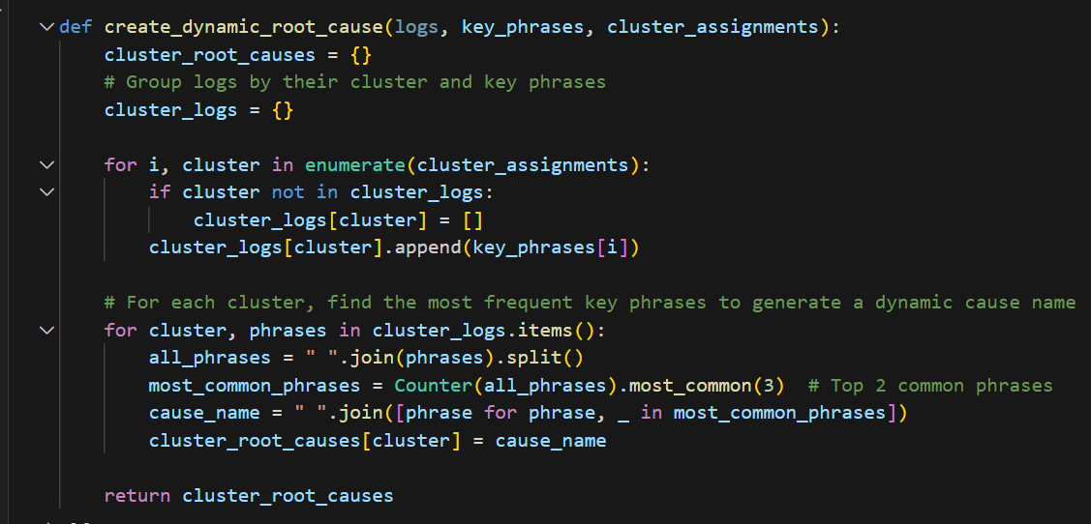
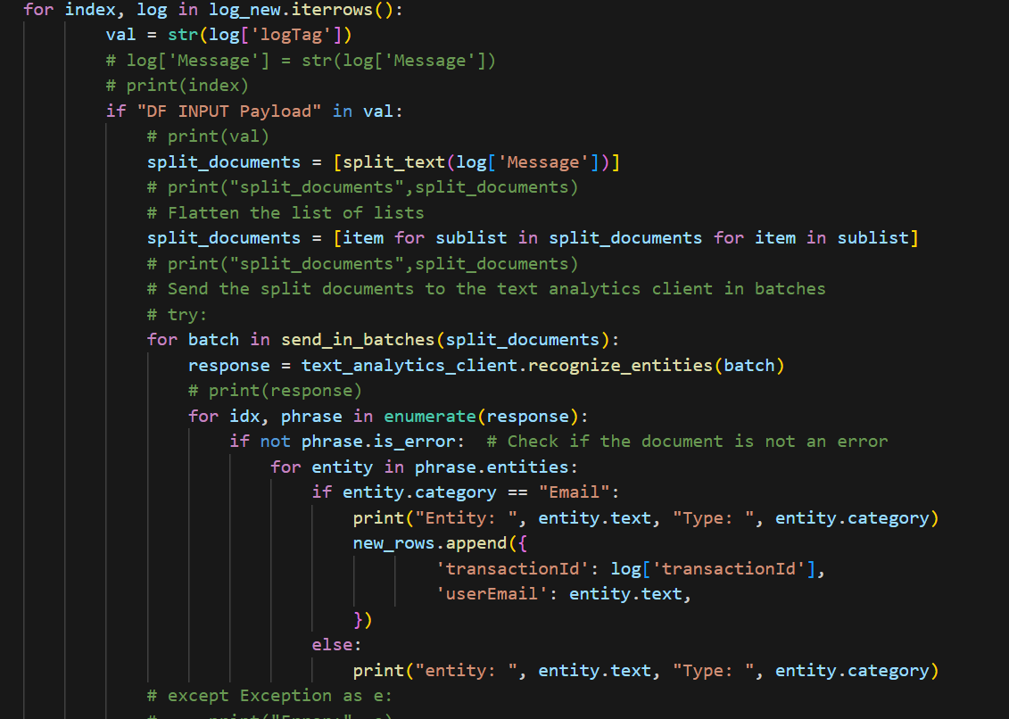
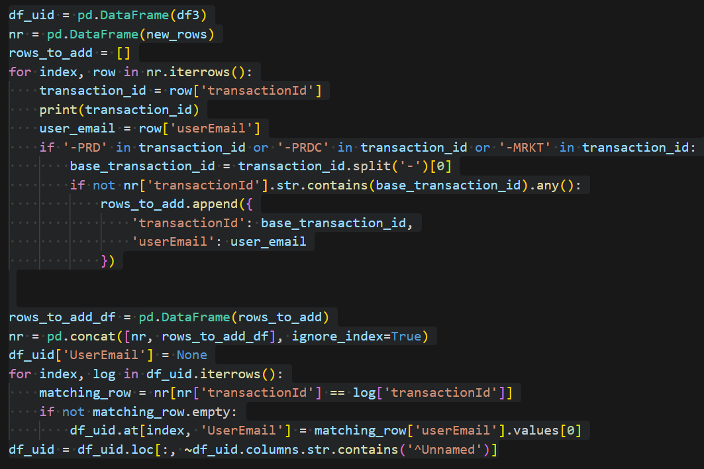
MACHINE LEARNING NOTEBOOK
Azure Cognitive Services, Azure ML & Clustering Algorithms:
Implement Clustering Algorithm
Analyze the specific content of log messages and cluster logs based on their context, enabling proactive issue identification.

Slide 25
Our Thought Process, Implementation
Next steps – like error code we can segment user selection based on dim selection , fact selection, etc
this will help to understand user selection , user profile, user popular reporting needs - this can help us to feed data to GenAI usecases as we know the user segmentation(profile, selection) - i.e wtih dim selection , fact selection. This will be potentially helpful in Ask Arthur to identiy when user does “my brand” in contextual search
this can also be useful in infra throttling user request by scaling AKS PODS and this will ensure performance is good
Compare current selection with past execution to reduce over-usage of data points prompts user that based on user history their current selection will exceed data point OR not - i.e based on datapoint consumed for previous selection . this will help to better costs as user cannot execute report if available credit is less.
Pre-cache With the logs are grouped based on user email id we can easily find the common reports run by user and if those reports always fetches from the DB based on their historical data we can precache the reports and selection.

Slide 26





Log Analysis to recognize entities especially user info
Use Automatic Grouping by user email to track logs even when user info is limited.
Grouping logs by user email across services is not possible in Datadog
It relies on transaction IDs, and few logs contain user email information.
Data Dog
Limitation
Approach
Provides insights into users’ common actions and reports
Enables log tracking across services for individual users
Azure Cognitive Services
Azure Cognitive Services groups logs based on user email, enabling better tracking across services.
Solution
Benefits

Slide 27




Predictive Monitoring (Log Categorization using NLP)
Make the diagram in center small and bring the relevant dashboard in slide7 here . So that you explain and show the graph
Logs are tagged only by severity levels (Error, Warning, Info)
Lack of Context: No in-depth understanding of the impact or context of log messages
Data Dog
Limitation
Log Impact Analysis (Service outages , User experience issues etc..)
Tag logs based on these analyses for better context
Approach
Azure Cognitive Services
Implement custom log categories (e.g., Cache Error, Server Error, Connection Error)
Analyze the specific content of log messages for enhanced categorization
Enables context-aware categories that go beyond basic severity levels
Provides direct insights within logs for quicker resolutions
Solution
Benefits

Slide 28
Predictive Monitoring (Log Categorization using NLP)
Logs are tagged only by severity levels (Error, Warning, Info)
Lack of Context: No in-depth understanding of the impact or context of log messages
Data Dog
Limitation
Log Impact Analysis (Service outages , User experience issues etc..)
Tag logs based on these analyses for better context
Approach
Azure Cognitive Services
Implement custom log categories (e.g., Cache Error, Server Error, Connection Error)
Analyze the specific content of log messages for enhanced categorization
Enables context-aware categories that go beyond basic severity levels
Provides direct insights within logs for quicker resolutions
Solution
Benefits

Slide 29
Azure Monitor – Dashboard : Predictive Monitoring

Slide 30
Automated Root Cause Detection - Make the diagram in center small and bring the relevant dashboard in slide8 here . So that you explain and show the graph
Root cause analysis is manual
slows down identifying the cause of system issues.
Data Dog
Limitation
Automatic Clustering by using machine learning K means Clustering to group logs based on their context
Approach
Azure Cognitive Services, Azure ML & Clustering Algorithms:
Implement Clustering Algorithm
Analyze the specific content of log messages and cluster logs based on their context, enabling proactive issue identification.
Accelerates root cause identification by clustering related logs automatically
Reduces manual investigation efforts, improving response times
Solution
Benefits

Slide 31
Automatic Clustering by using machine learning K means Clustering to group logs based on their context
Root cause analysis is manual
slows down identifying the cause of system issues.
Data Dog
Limitation
Approach
Azure Cognitive Services, Azure ML & Clustering Algorithms:
Implement Clustering Algorithm
Analyze the specific content of log messages and cluster logs based on their context, enabling proactive issue identification.
Accelerates root cause identification by clustering related logs automatically​
Reduces manual investigation efforts, improving response times​
Solution
Benefits

Slide 32
Automatic Clustering by using machine learning K means Clustering to group logs based on their context.
The number of clusters are determined by silhouette_score
Root cause analysis is manual
slows down identifying the cause of system issues.
Data Dog
Limitation
Approach
Azure Cognitive Services, Azure ML & Clustering Algorithms:
Implement Clustering Algorithm
Analyze the specific content of log messages and cluster logs based on their context, enabling proactive issue identification.
Accelerates root cause identification by clustering related logs automatically​
Reduces manual investigation efforts, improving response times​
Solution
Benefits

Slide 33
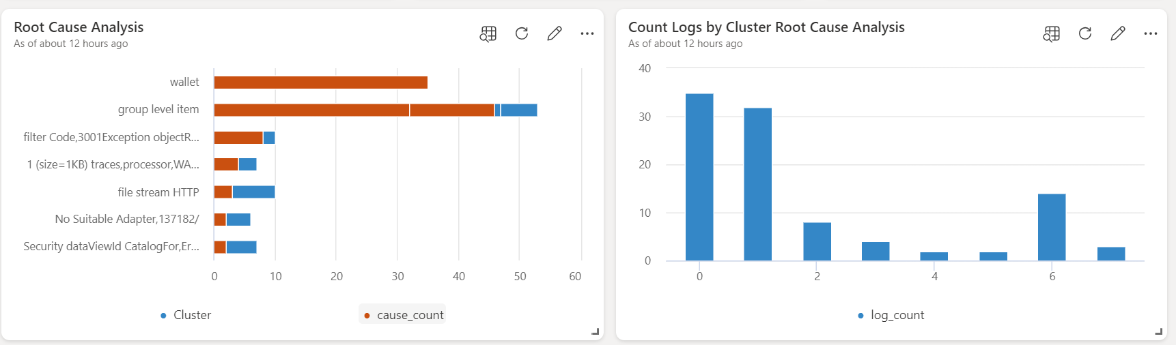
Azure Monitor – Dashboard : Root Cause Detection

Slide 34
User Behavior Analytics – Make the diagram in center small and bring the relevant dashboard in slide9 here . So that you explain and show the graph
Grouping logs by user email across services is not possible in Datadog
It relies on transaction IDs, and few logs contain user email information.
Data Dog
Limitation
Log Analysis to recognize entities especially user info
Use Automatic Grouping by user email to track logs even when user info is limited.
Approach
Azure Cognitive Services
Azure Cognitive Services groups logs based on user email, enabling better tracking across services.
Provides insights into users’ common actions and reports
Enables log tracking across services for individual users
Solution
Benefits

Slide 35
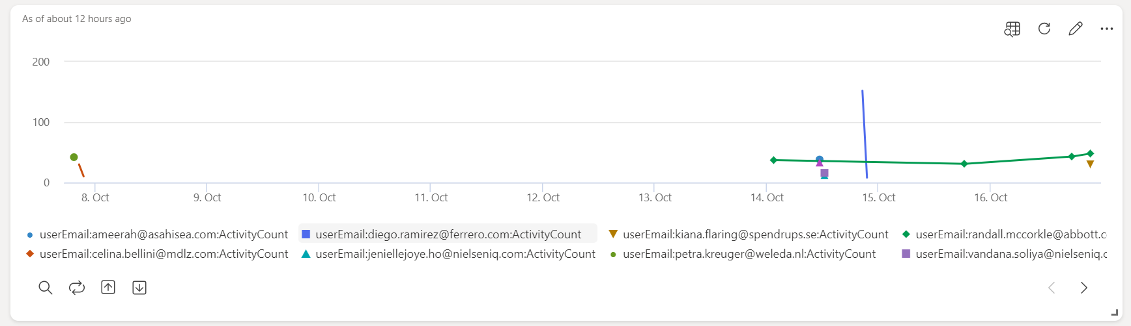
Azure Monitor – Dashboard : User Behavior Analytics

Slide 36
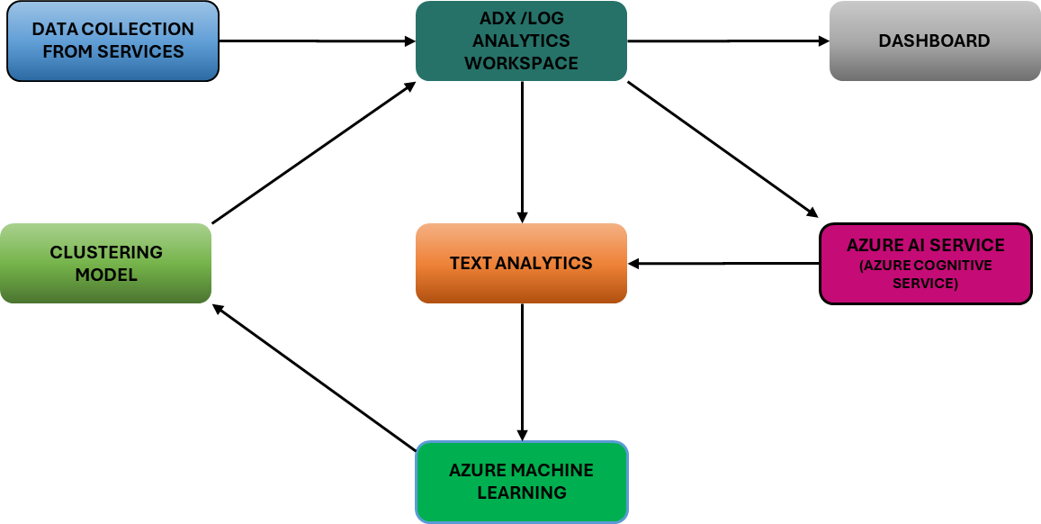
Process Flow Diagram – the bullet point 3, 4, 5 in left is not in sync with diagram e.g the arrow direction
Data Collection:
Logs collections > Ingestion into ADX/Log Analytics
Data Processing and Enrichment:
Azure AI Service > Text Analytics > Extract Insights from Logs > Store in Custom Table in ADX
Advanced Analytics and Clustering:
Azure ML > K-Means Clustering > Group Logs Based on Patterns > Store in Custom Table in ADX
Visualization :
Azure Dashboard > Real-Time Monitoring, Clustering, and Predictive Analytics.

